Slide 1
Welcome to Effective Verbal AND Written Communication workshop
Notes:
Duration: Project this slide till such time the participants settle down in the room.
Facilitator Notes:
Ensure you have all the necessary handouts ready.
Check for
In a Virtual Session:
Ensure the connections are established across all locations.
Ensure you have the deck loaded and are able to effortlessly move from one slide to the other. Ahead of the session, check if the video links are working fine.

Slide 2

Facilitator Introduction
What is Your Story?
The Single Biggest Problem In Communication
Course Objectives
Course introduction
2
Notes:
Duration: 1 minute
Facilitator Notes:
You should have completed the following before facilitating this session:
Reviewed the facilitator notes on this deck and familiarized yourself with the activities set-up and debrief requirements.
Prepared your introduction using the key pointers on the Introduction slide
 Explain:
Welcome to the two-day course on Effective Verbal and Written Communication.
The intent of this course is to help you gain an insight on the importance of acquiring and demonstrating effective communication skills–spoken and written – at the workplace. On completing this course, you will understand the significance of communication skills, which are as important as the technical skills that you display in the professional space. You will also gain a fair amount of practical experience in applying some of the key communication tools and techniques that we will discuss and review through the next two days.
In a Virtual Session:
Inform the participants that there will be activities throughout the session – some will be discussions while others group activities. Instruct the participants to use their desk mics to unmute themselves and respond whenever they choose to share their thoughts, ideas, questions. Emphasize that this is a workshop on effective communication and in order for it to be truly effective, we will need to communicate openly. And actively participate throughout the two day workshop.
Transition:
Before we get started, I would like to introduce myself. I am…. (use the next slide to introduce yourself)

Slide 3

I am…
Been with Accenture for…
Part of…
My Top 5 Strengths are…
In my free time, I love to…
Copyright © 2017 Accenture. All rights reserved. For Accenture Internal Use Only.
3
Notes:
Duration: 1 minute
Facilitator Notes:
Introduce yourself quickly using the pointers on the slide
Transition:
We are after all going to spend the next two days learning from each other, so let’s get to know each other better, shall we!

Slide 4

What is your story?
Every name has a story!
Share with the group any stories, facts, history, background, about your names, either first or last.
Copyright © 2017 Accenture. All rights reserved. For Accenture Internal Use Only.
4
Notes:
Duration: 10 minutes
Facilitator Notes:
Introduce the activity by explaining that its objective is to give participants a chance to get to know one another better.
Ask each participant to share with the group any stories, facts, history, background, etc., about his or her names, either first or last.
As facilitator, be sure to share the story of your name as well with the group.
Note:
If the group size is more than 10, you could break the group into smaller groups of 4 and have them interact and share their stories among the groups.
An alternative is to have the participants pair up, share information about each other and have them introduce each other. This is recommended when you have a smaller group as you will have more time at hand.
In a Virtual Session:
Follow similar approach at each location. Ensure everyone is introduced. If the audience size is significantly large, have at least 4 or 5 people introduce themselves from each location. However, do so only after they have completed the introductions at their respective locations in pairs or small groups.
Transition:
I hope this activity has helped you know your co-participants a little better now than at the start of this course. We are here to discuss Effective Communication; having said so, what do you think are some of the problems in communication? In fact, there is one major factor that acts as a barrier in effective communication…

Slide 5
The single biggest problem in communication
is the illusion that it has taken place.
- George Bernard Shaw
Copyright © 2017 Accenture. All rights reserved. For Accenture Internal Use Only.
Notes:
Duration: 10 minutes
Facilitator Notes:
Ask the participants what they think or understand of this quote.
Use this slide as a lead-in to ask the participants the reason they are attending the two-day workshop.
Use a flipchart or a section of the wipe board to capture some of the key reasons. Typically, while the participants share their expectations, their day-to-day struggles with communicating may also surface.
 Explain:
I want you all to take a moment and let this quote sink in. To begin with, how many of you have heard of George Bernard Shaw? Quick trivia: He was an Irish playwright, critic and polemicist who was known for the marked influence he had on Western theatre, culture and politics even beyond his death.
What do you think is the key word in this sentence? – ‘Illusion’. How do you relate this in a modern day scenario? How many times have you faced a situation where a problem has been created due to a miscommunication, or ineffective communication? Think of examples in both your personal and professional lives.
The other assumption is that we believe we need effective communication mostly at workplace and not in our personal lives; we assume that since we ‘know’ our family/friends better, we don’t need to be conscious of how we communicate with them. You would agree with me that this is not entirely correct; I’m sure we’ve all been in personal situations where our words/talks/behavior have been misconstrued or misunderstood.
Communication is very important to ALL inter-personal discussions, as it is how we move ideas from person to person. When communication goes awry, part of the idea is lost or misunderstood by the other person. The other person thinks they have the idea, but in fact it is, at best, not quite right and at worst it can lead to something disastrous. This is the problem the quote is discussing.
Continued on next page

Slide 6
Note to Facilitator: This is a HIDDEN SLIDE that includes the Facilitator notes for the previous slide. This will not show in Slide View mode when hosting the session.
The single biggest problem in communication
is the illusion that it has taken place.
- George Bernard Shaw
Copyright © 2017 Accenture. All rights reserved. For Accenture Internal Use Only.
Notes:
Continued from previous page
The quote speaks of the illusion that communication has occurred, but in actuality, it has not. Both people think they understand what has been passed between them, but the ideas they have are not the same. This is where the illusion of communication can be most damaging.
Communication is about behavior. So, working on your communication is about changing behavior. And the best way to learn that is by doing, practicing, discussing, experiencing, reflecting.
What that means for each one of you is that over the next two days you are going to be “practicing” most of the time, coupled with a little bit of “watching” and “listening”. The amount of learning you will get out of this course depends on how you reflect on the “practice” you get throughout the workshop.
What are your problems in communication that you wish to address in this course? What do you want to achieve? (Facilitator to list responses on the flipchart or on one side of the wipe board)
Transition:
Thank you. Let us take a look at what we will be covering in the next two days.

Slide 7
By the end of this course, you will be able to:
Define the communication process
Discuss the significance of effective communication at the workplace
Identify the common barriers to effective communication and determine ways to overcome them
Identify the types of communication and list the ways in which we can communicate at work
Use the communication tools—powerful questioning, active listening, paraphrasing and feedback techniques to enhance your communication skills
Discuss the approach when communicating with teams
Discuss how to improve client conversations and how to handle difficult conversations with clients
7
Notes:
Duration: 1 to 2 minutes
Facilitator Notes:
Use this slide to highlight the high level course objectives for the two day workshop. You can either read it yourself or invite one of the participants to read off the slide.
Instruct that this is a workshop on Effective Communication skills and will be a successful workshop only if there is a two way participation through out.

Slide 8
By the end of this course, you will be able to (CONTD):
Understand how to structure your communication
Identify challenges faced in developing a message and means to overcome them
Explore the structured communication process
Review the different communications methods available at Accenture
Practice the right way to write
Discuss the importance of tailoring your message to your audience
Understand cultural differences and ways to manage them
Discuss SOCIAL STYLEs and its benefits
Practice scenarios and roles plays
8
Notes:
Duration: 1 to 2 minutes
Facilitator Notes:
Use this slide to highlight the high level course objectives for the two day workshop. You can either read it yourself or invite one of the participants to read off the slide.
Instruct that this is a workshop on Effective Communication skills and will be a successful workshop only if there is a two way participation through out.

Slide 9

Questions around the table?
Copyright © 2017 Accenture. All rights reserved. For Accenture Internal Use Only.
9
Notes:
Duration: 1 or 2 minutes
Facilitator Notes: Use this space to pause and check if participants have any questions based on the content covered so far. Address questions that are critical and those that will be addressed later in the course, ensure to park them some place such as a portion of your wipe/white board or a flipchart specially assigned for parking questions.
Transition:
So let’s get started with Module One.

Slide 10
The Communication Process
Communication Types
Video: Importance of Effective Communication
Benefits of Effective Communication
Different Strokes for Different Folks
An Integrated Approach to Communication Styles
MODULE ONE Communication fundamentals
10
Notes:
Duration: 1 minute
Facilitator Notes: This slide lists the topics to be covered in module one.
DO:
Read the content on the slide.
Explain:
In this module, we will discuss the importance and benefits of effective communication. We will also watch a video on the importance of effective communication and discuss the benefits of communicating effectively at the workplace. We will also spend some time to understand what are the barriers to communication.
Transition:
Let us begin this module with a quick discussion on what are your reasons to communicate with someone.

Slide 11


What are your reasons to communicate with someone?
To Inform
Provide information for use in decision making
To Persuade
Reinforce or change a receiver’s belief about a topic
To Build Relationships
Build good will between you and the receiver
The goal of communication is not just for you to deliver your idea but also to build a bridge between two people and meet in the middle.
11
Notes:
Duration: 5 minutes
Facilitator Notes:
Do
Ask participants to share their reasons for communicating with others.
Elicit quick responses from the audience.
Then display the three key reasons for communicating. Use the points provided below to further elaborate.
 Explain
Communication is central to all aspects of life. It’s a critical skill for maintaining your personal as well as professional relationships.
We typically communicate for any of these three reasons:
To Inform
To Persuade
To Build Relationships
Transition
We know the key reasons we communicate with someone. But why do we need to communicate effectively?

Slide 12
The communication process
The process of communication is what allows us to interact with other people.
Sender The source of a message
Reply Contains feedback information, clarifying questions as well as additional information.
Message Made up of symbols that have meaning for both the sender and receiver.
Receiver Interprets message, gives feedback, which helps to clarify or confirm the message.
12
Notes:
Duration: 5 minutes
Facilitator Notes: Use this slide to discuss the communication process.
DO:
Present the content on the slide and use the notes provided below to explain.
Explain:
The communication process is what allows us to interact with other people. It is a process by which information is exchanged between individuals through a common system of symbols, signs, or behavior.
Without communication, we would be unable to share knowledge or experiences with anyone else. Common forms of communication include speaking, writing, gestures, touch and broadcasting.
The communication process comprises the following key elements:
Sender is the person who encodes the information and sends it to the receiver through a medium. The sender must know why the communication is necessary and what result is needed.
Message is the key information that needs to be communicated or shared.
Medium is the intermediary or channel between the sender and the receiver through which the communication is done. The type of message the sender has determines the medium that should be used and can include face-to-face conversations, telephone calls or videoconferences, and written communication like emails and memos.
Receiver is the person who decodes the received information and replies in the sense of feedback or reply.
Reply comprises feedback information, clarifying questions as well as addition information. The feedback lets the sender gauge how successful they were in communicating. It also offers a chance to adjust the communication process for the future.
Continued on next page

Slide 13
The communication process
The process of communication is what allows us to interact with other people.
Sender The source of a message
Reply Contains feedback information, clarifying questions as well as additional information.
Message Made up of symbols that have meaning for both the sender and receiver.
Receiver Interprets message, gives feedback, which helps to clarify or confirm the message.
Note to Facilitator: This is a HIDDEN SLIDE that includes the Facilitator notes for the previous slide. This will not show in Slide View mode when hosting the session.
13
Notes:
Continued from the previous page
Medium is the intermediary or channel between the sender and the receiver through which the communication is done. The type of message the sender has determines the medium that should be used and can include face-to-face conversations, telephone calls or videoconferences, and written communication like emails and memos.
Receiver is the person who decodes the received information and replies in the sense of feedback or reply.
Reply comprises feedback information, clarifying questions as well as addition information. The feedback lets the sender gauge how successful they were in communicating. It also offers a chance to adjust the communication process for the future.
Communication is essentially the art and process of creating and sharing ideas. Effective communication depends on the richness of those ideas.
Transition:
We’ve looked at the communication process and understood the key elements within this process. Why is it important to communicate effectively?

Slide 14
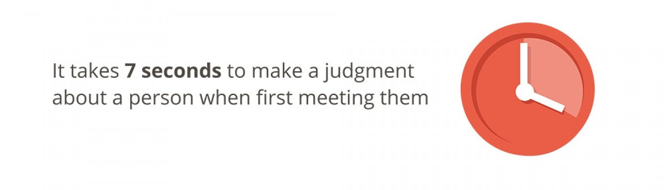
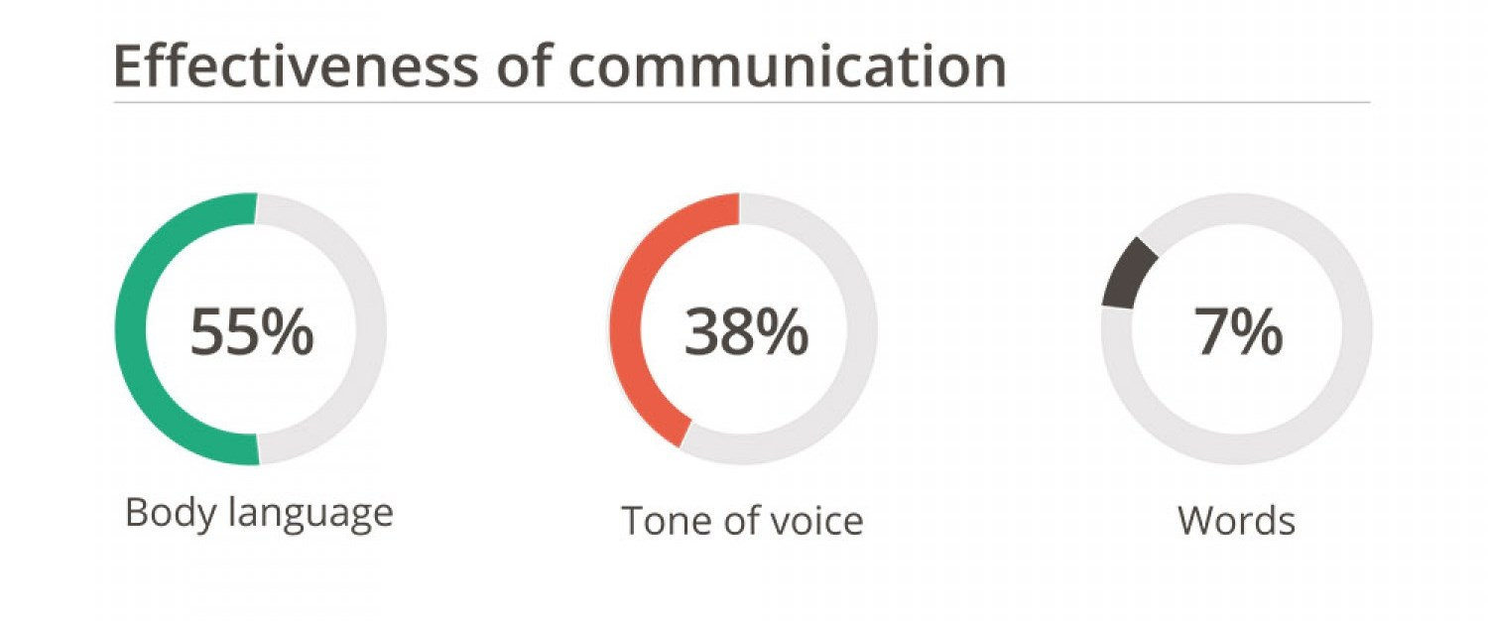
Why communicate effectively?
14
Notes:
Duration: 5 minutes
Facilitator Notes:
Use this slide to build in the importance about communicating effectively at work and to draw out the impact of first impressions.
Use a flipchart or a section of the wipe board to capture some of the key reasons.
Ask participants to list the components of verbal communication, and their importance. Build on the importance on ‘how’ of communication, in addition to that ‘what’
 Explain:
Why must we communicate effectively? Think of only your workspace at this point
DO: Click to display the first text box
 Explain:
Research states that it takes 7 seconds to make a judgment about a person when first meeting them. Would you agree with this?
How many of us have been victims of first impressions? How would first impressions impact your interpersonal relations at the workspace?
If we talk of verbal communication, what other elements must you be careful of?
How important do you think body language/tone/words are? What percentage of importance would you place on each of them?
DO: Click to display the second text box
Continued on next page

Slide 15

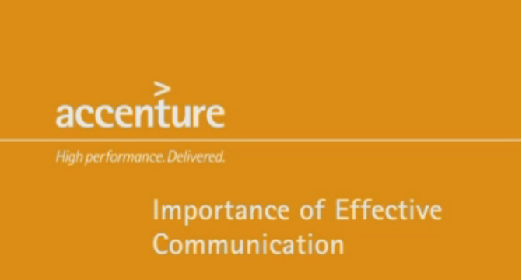
Importance of effective communication
What key messages did you gather from this video?
15
Notes:
Duration: 8 - 10 minutes
Facilitator Notes:
This video highlights the importance of effective communication. It shows Accenture leaders talk about the key tools one can use to ensure they communicate effectively.
 Explain:
In this video, Accenture Leaders share their insight as to why it's extremely important to learn how to effectively communicate at Accenture.
DO:
Play the video Importance of Effective Communication - From a Senior Executive's Perspective. Either use the hyperlink embedded on the slide or alternatively use the following link to play the video from MediaExchange: https://mediaexchange.accenture.com/media/0_xq2bz92q
Once you’ve played the video, ask the participants what key messaged did they gather from this video. Use this question to get some amount of discussion going.
Transition:
We’ve seen what our leaders at Accenture have to say about effective communication. Now, let us look at the types of communication.

Slide 16

What are the benefits of effective communication?
Builds employee morale and fosters team work
Encourages collaboration and innovation
Helps foster inclusion and diversity, and increases global reach
Engages clients effectively
16
Notes:
Duration: 5 minutes
Facilitator Notes:
Do
Discuss the benefits of communicating effectively in the workplace.
Share that effective communication helps to understand a person or situation in a better way. Use the notes provided below to further explain the key points listed on the slide.
 Explain:
Being able to communicate effectively with others is important to our psychological well-being for a number of important reasons. Effective communication is a two way process – sending the right message to the right person.
Effective communication skills are valuable in the workplace. The benefits of employees, supervisors and leaders communicating effectively translate into huge rewards for the business itself.
Effective communication has the following benefits:
Builds employee morale and foster team work: Effective communication in the workplace helps employees and supervisors form highly efficient teams. Employees are able to trust each other and management.
Employees know their roles on the team and know they are valued. Supervisors are able to provide feedback without creating a hostile work environment. A supervisor who openly communicates with his team can foster positive relationships that benefit the company as a whole.
Encourages collaboration and innovation: When communication channels are kept open and transparency is maintained through effective communication, it fosters a collaborative atmosphere which further supports synergy among teams thus encouraging innovation.
Continued on next page

Slide 17

WHAT ARE THE WAYS IN WHICH YOU COMMUNICATE WITH OTHERS?
WHAT COMMUNICATION MEDIA DO YOU USE AT WORK?
Internal communication
Based on audience
External communication
Communication Types
Formal communication
Based on formality
Informal communication
Written communication
Based on media
Verbal communication
Non-verbal communication
17
Notes:
Duration: 3 minutes
Facilitator Notes: This slide lists out the forms of communication.
DO:
Start a quick discussion using the two questions. Elicit responses from the participants.
Then use the flowchart on the slide to highlight the key types of communication. Use the notes below to support your explanation.
Explain:
Communication is key to maintaining successful business relations. For this reason, it is paramount that we build strong communication skills. For ease of understanding, communication can be categorized under three key types:
Based on audience:
Internal communication: process of exchanging information among the people of different levels within the organization.
External communication: process of exchanging information with the people of various external or outside parties of the organization.
Based on formality:
Formal communication: process of exchanging information by following the prescribed or official rules, procedures, systems formalities, chain of command etc. in the organizational structure.
Informal communication: process of spontaneous exchange of information among various people of different status in the organizational structure.
Based on media:
Written communication: process of communication in which messages or information is exchanged or communicated within sender and receiver through written form. Written communication is essential for communicating complicated information, such as statistics or other data, that cannot be easily communicated through speech alone.
Continued on next page

Slide 18
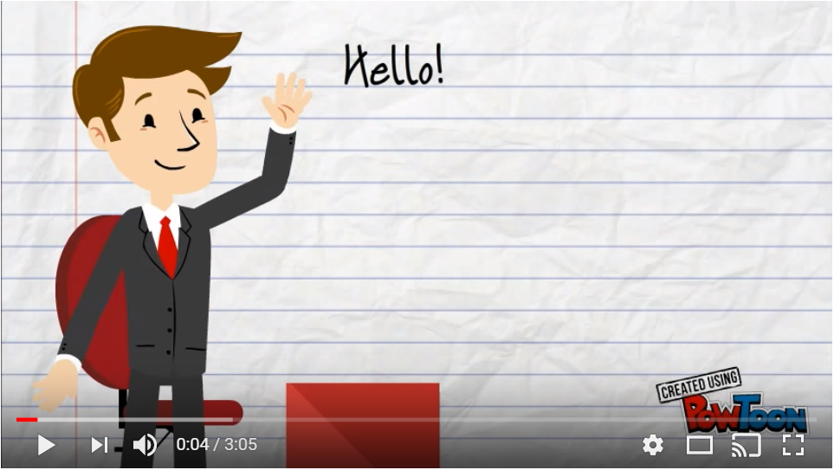
Types of communication
Is non-verbal communication just as important as verbal communication?
18
Notes:
Duration: 5 minutes
Facilitator Notes: This video talks the types of communication. There are two types of communication – verbal and non-verbal communication.
DO:
Play the video either using the embedded link on the slide or alternatively use the following YouTube link: https://www.youtube.com/watch?v=Nhg1_6NdDfo
Once you’ve played the video, ask the participants if non-verbal communication is just as important as verbal communication?
Elicit quick responses from the participants and state that non-verbal communication
Transition:
Let’s take a look at all the elements of communication

Slide 19




Elements of communication: Body language
Facial Expressions
Non-verbal
Signals
Gestures
Posture and Movement
Eye Contact
19
Notes:
Duration: 5 minutes
Facilitator Notes: The purpose of this slide is to help participants recognize the various non-verbal elements that impact communication.
DO:
Ask the participants if they remember/recall the components of communication and the weightage given to each.
Display the infographic that highlights that 55% of the focus in a communication is on the body language and other non-verbal signals provided.
Explain:
According to experts, a substantial portion of our communication is nonverbal. Every day, we respond to thousands on nonverbal cues and behaviors including postures, facial expression, eye gaze, and gestures. From our handshakes to our hairstyles, nonverbal details reveal who we are and impact how we relate to other people. In many cases, we communicate information in nonverbal ways using groups of behaviors. For example, we might combine a frown with crossed arms and unblinking eye gaze to indicate disapproval.
Nonverbal communication plays an important role in how we convey meaning and information to others, as well as how we interpret the actions of those around us. The important thing to remember when looking at such nonverbal behaviors is to consider the actions in groups. What a person actually says along with his or her expressions, appearance, and tone of voice might tell you a great deal about what that person is really trying to say.
Facial Expressions are responsible for a huge proportion of nonverbal communication. Consider how much information can be conveyed with a smile or a frown. The look on a person's face is often the first thing we see, even before we hear what they have to say.
Continued on next page

Slide 20
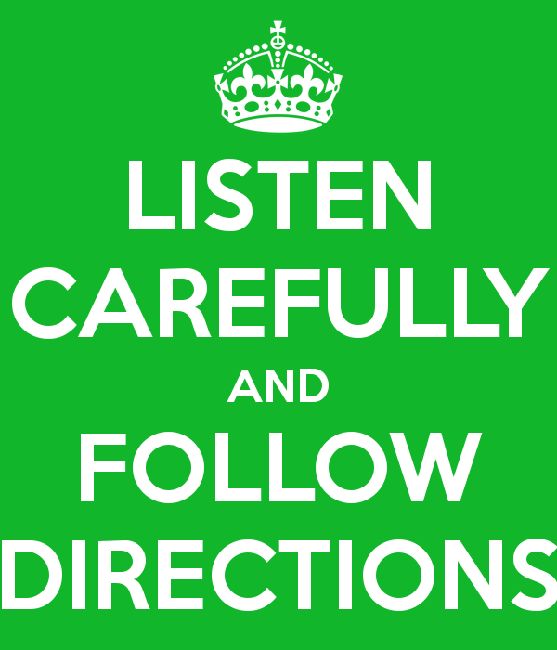
activity
20
Notes:
Duration: 3 minutes
Facilitator Notes: This is a quick fun activity that works on highlighting the power of body language.
Explain:
Body language speaks louder than any words you can ever utter. Whether you’re telling people that you love them, you’re angry with them, or don’t care less about them, your body movements reveal your thoughts, moods, and attitudes.
Both consciously and sub-consciously your body tells observers what’s really going on with you.
DO:
Explain to the group that you are going to give them a series of instructions, which you would like them to copy as fast as they can
State the following actions as YOU do them:
Put your hand to your nose
Clap your hands
Stand up
Touch your shoulder
Sit down
Stamp your foot
Cross your arms
Put your hand to your mouth – BUT WHILE SAYING THIS PUT YOUR HAND TO YOUR NOSE
Observe the number of group members who copy what you did rather than what you said.
Facilitate discussion on how body language can reinforce verbal communication and can also be stronger than verbal communication.
Transition:
Now that we’ve seen how non-verbal elements impact conversations, let us look at the verbal elements.

Slide 21

Elements of communication: Tone of voice
Volume of voice (loudness / softness)
Pace or speed of voice
Intonation and Stress (rise and fall in voice)
Tone of voice (feelings and emotions expressed)
Pronunciation (manner in which word is uttered)
Articulation (clarity in the voice)
Pause ( a break taken while speaking)
Punctuation Marks (use of conventional symbols and spacing)
21
Notes:
Duration: 10 minutes
Facilitator Notes: The purpose of this slide is to help participants recognize the various vocal elements in communication, and discuss ways to address them. It uses an infographic shown in a previous module to remind participants the importance of ‘how to say’ vis-à-vis ‘what to say’
 Explain:
On the previous slide, we saw how 55% of the communication is focused on Body language and other non-verbal elements of communication. Do you recall what the remainder 45% was split across?
DO:
Show the infographic
Explain: We spoke of ‘how’ we say something matters so much more (38%) than ‘what’ we say (only 7%). Think about some skype calls. Aren't some of our meetings better than others? How many of you have been on a call where the speaker was extremely low on energy and was speaking in a flat tone? How effective was that meeting at the end of your day? Think about some instances where you’ve had to experience some disturbances – heavy breathing, microphone held too close, background noise, etc? How was your overall experience then?
DO:
Ask the participants to give you a generic short sentence (preferably non-work related). Next, ask for 5 volunteers from the room. Step outside the room with the volunteers, and give them each one emotion to act out while saying the sentence – anger, fear, sarcasm, humor, sorrow. Ask the audience to identify which mood was being conveyed and what were the verbal and non verbal signals they used to aid their interpretations.
Continued on next page

Slide 22

Why is each situation different?
What are the expectations of each person?
What would happen if you greeted your friends in the way you greeted your client?
What would happen if you greeted your manager the same way you greet your friends?
Does the way you communicate (or say things) affect how others perceive you?
22
Notes:
Duration: 10 - 15 minutes
Facilitator Notes:
The purpose of this activity is to encourage the participants to discuss the different types of communication they might use in different situations and environments. It introduces the idea that language/communication varies by context – and that it’s important to understand what might be acceptable and expected in one setting may not be appropriate in another.
DO:
Group the participants into 4 or 5 teams. Assign each team one situation listed in the handout. Have the participants first fill out the handout with their individual responses. Give them 2 minutes to complete this activity.
Then within their assigned teams, have them discuss and exchange their responses for the specific situation assigned. Spend no more than 3 minutes on this discussion.
Invite each team to describe or demonstrate how they communicate in the given situation with their friends, their family members. Then ask them how they will communicate with their peers/colleague and their manager. Finally, ask how they are likely to communicate with their client or stakeholder.
Have all four or five teams complete this presentation/demonstration. Ensure all team members have a go. Give each team a minute or two. After every team finishes presenting, check if other teams have any different responses and have them share.
Discuss the differences and similarities in the participants’ responses.
To debrief the activity, ask the group the questions listed on the slide. These questions appear on mouse click. Do not reveal these questions until you have arrived at the debrief point in the activity.
Transition:
As we have seen from this activity, our communication clearly is affected by the audience we choose to address. Let’s spend some time to further understand this audience specifically in the workplace and see how, within this group, there are differences.

Slide 23




Different Strokes for Different Folks
Baby Boomers
The “Old School”
Gen X
The PowerPoint and
Outlook Generation
Gen Y/ Millennial The Facebook Generation
Gen Z Immersive, Go where they are…
In-person communication
Detail oriented
Prints! ☺
Preferred Style: Phone calls, personal interaction
Structured approach
Exploratory and hands on approach
Link key messaging to the broader picture
Preferred Style: Email/Voice mail
Collaborative
Keep it short and crisp
Hard hitting, bold messages to drive attention
Preferred Style: IM, Blogs, Videos, Social Media
Interactive
High focus on visual appeal
Preferred Style: IM, Blogs, Videos, Social Media, AR & VR
23
Notes:
Duration: 15 minutes
Facilitator Notes:
The purpose of this slide is to help drive the importance of communication vehicles at work and how to leverage each vehicle for our audience type. It will be facilitated through a discussion and open Q&A.
 Explain:
At the modern workplace, we interact and communicate with various generations, sometimes individually, and sometimes as mixed groups.
This slide helps uncover the four common generations known, and how one should communicate with them, to reach the desired outcome of the intent to communicate.
DO:
Before revealing the 4 generations, the Facilitator should ask the participants if they are aware of the ‘gens’ and if they could name them. While there are no clear years of demarcation, the 4 generations could be categorized roughly in the following year ranges: (Reveal the graphics now)
Baby Boomers (Born between 1946 and 1964)
Generation Xers (Born between 1965 and 1980)
Generation Ys or Millennials (Born between 1980 and 1995)
Gen Zs (Born after 1995)
Let’s talk about each of the four generations. (Divide the room in 4 groups, with each group addressing a particular generation).
In your teams, list down some of the preferred communication approaches for each of your generations. First think about their socio-economic backgrounds, access to information, and subsequent orientation and priorities. Use this information to think about what would be their preferred style of communication.
Continued on next page

Slide 24
An integrated approach
The medium is as important as the message
Use technology as a key enabler for collaboration
Personalization is appreciated by everyone
Understand and respect value differences
Be aware of motivating factors
24
Notes:
Duration: 2 minutes
Explain: At Accenture, our peers, teams, clients, stakeholders and colleagues comprise a blend of the four generations we’ve just discussed. Therefore, we need an integrated approach to our communication style. Lets discuss what this can be.
DO:
Click for each recommendation and talk through the main points, building on what may have been discussed in the class earlier. Relate these points to the content on the previous section where we discussed about personalizing the messaging based on who we are speaking with.

Slide 25

THE INTERNET AND SOCIAL MEDIA HAS CHANGED HUMAN BEHAVIOR
13
seconds
9
seconds
8
seconds
3-5
seconds
Average attention span in 2000
Average attention span of a goldfish
Average attention span in 2015
Average time you have to make an impression online
25
Notes:
Duration: 3 minutes
DO:
Reveal just the statement on the slide – The Internet and Social Media has changed human behavior. Ask the participants what they understand from this.
Elicit responses and ask participants to share specific responses – ensure to gather both work-related as well as non-work related examples.
Summarize the key points provided on the slide one after the other to highlight how human behavior has seen a paradigm shift and that everything now is on the go.
Explain:
In the olden days, typical attention span is 20 mins. With the emergence of electronic media, this has been reduced to seconds.
It is of utmost importance to get your point across quickly and effectively.
Transition:
The simplest way to ensure this is to KISS… (reveal next slide)

Slide 26


Copyright © 2017 Accenture. All rights reserved. For Accenture Internal Use Only.
26
Notes:
Duration: 1 Minute
Explain:
Keep It Simple and Short – that is the mantra to effective communication!
Less is More – having a minimalistic approach is more effective. Simplicity and clarity lead to good design.

Slide 27
Questions around the table?
Copyright © 2017 Accenture. All rights reserved. For Accenture Internal Use Only.
27
Notes:
Transition:
This brings us to the end of Module One. Does anyone have any questions on what we have covered so far? (Address any clarifying questions one may have and if any of the questions are likely to be addressed through the contents that follow, make sure to list the questions on the wipe/white board or on the flipchart meant for questions. Ensure you let the participants know that you are parking a few questions as they will get answered later on in the course.)
Now that we are familiar with the composition of our audience at the workplace, lets take a quick 15 minute breather.

Slide 28

Break
Copyright © 2017 Accenture. All rights reserved. For Accenture Internal Use Only.
28
Notes:
COFFEE/TEA BREAK
Duration: 15 minutes
On return:
Welcome back and I hope you’ve had enough time to enjoy a cup of coffee/tea and give your lungs some fresh air!
Just before we took a break, we looked at the various components of communication and the composition of our audience at the workplace.
Now let’s move on to Module Two.

Slide 29
Activity: An Alien and His Shoes
The 7 Cs of Effective Communication
Communication Barriers and ways to overcome them
Key tools to communicate effectively
Communicating with teams
Client Conversations and handling difficult conversations
MODULE Two communication Techniques and tools
29
Notes:
Duration: 1 minute
Facilitator Notes: This slide lists the topics to be covered in module two.
DO:
Read the content on the slide.
Explain:
In this module, we will look at what we can do to make communication effective, identify some of the common barriers and discuss ways to overcome them. We will also look at some of the key tools we can use to ensure we communicate effectively.
Transition:
Let us begin this module with a fun activity.

Slide 30


An Alien and his shoes
30
Notes:
Duration: 15 minutes Facilitator Notes:
Handout: EVWC_M02_NEW_HANDOUT_Tennis Shoe Alien
Use this Tennis Shoe Alien activity to trigger discussion on the basic principles of effective communication. Participants learn to give clear instructions by verbally instructing an “alien” to put on a sock and tennis shoe – they aren’t able to demonstrate.
DO:
There are two ways to conduct this activity:
1) Trainer acts as Alien (need to bring shoes with laces)
2) One participant is selected as Alien
You do not introduce this activity verbally. At the start of the activity, what happens simultaneously is:
Participants are handed out the instruction leaflet.
The trainer/participant acting as Alien walks in and sits down on the chair mid-front, with one shoe and sock off, lays this shoe and sock next to his bare foot, and waits for instructions
Participants should take turns in presenting the Alien with an instruction. In case of two trainers, one trainer facilitates participants taking turns to give instructions.
Note: Most important is that the person playing Alien follows any instructions they receive literally and exactly to the letter. For example, if someone says “take your sock and put it on your foot”, the Alien should take the sock and lay it on their foot.
While tying a shoe is an everyday skill, this activity reminds you that specific directions and guidelines in even the most mundane tasks are required to be successful.
Transition:
We just saw how even in the most basic situations, lack of appropriate communication can cause confusion. Let’s watch a video that covers the elements of effective communication.

Slide 31
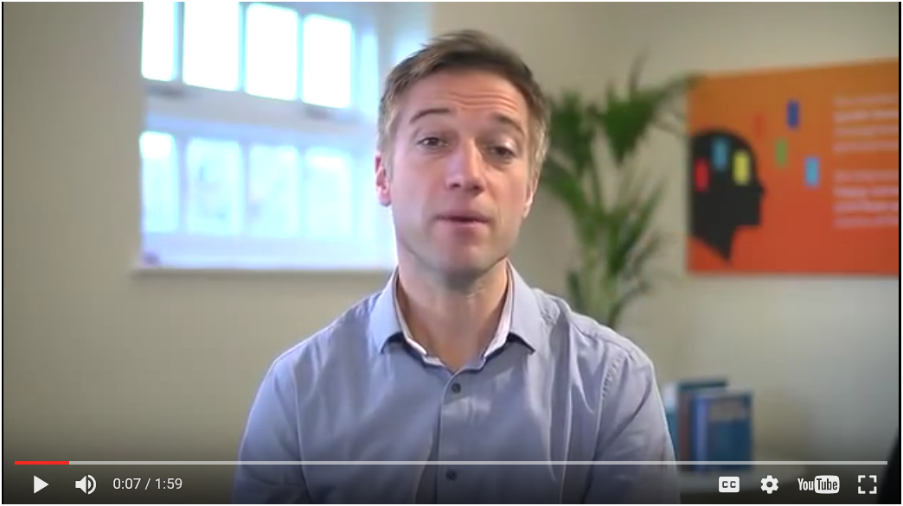
The 7c’s of effective communication
What key messages did you gather from this video?
31
Notes:
Duration: 7 minutes
Facilitator Notes: This video talks about the 7Cs of Effective Communication. Play this video and then use it to build your de-brief from the previous activity.
DO:
Play the video either using the embedded link on the slide or alternatively use the following YouTube link: https://www.youtube.com/watch?v=v4OmXaihEp0
Once you’ve played the video, ask the participants to think about the previous activity, and whether their communication to the alien was clear, concise, concrete, correct, coherent, complete and courteous. Use this discussion to generate some engagement and to create some humor in the room!
Transition:
Let’s do a quick recap of those 7 Cs.

Slide 32
RECAP: THE 7 C’S of effective communication
Clear
The 7 Cs of effective communication serve as a checklist and are applicable to both written as well as oral communication.
The better we communicate, the more credibility we'll have with our clients, our boss, and our colleagues.
Effective Communication
Concise
Concrete
Correct
Coherent
Complete
Courteous
32
Notes:
Duration: 3 minutes
Facilitator Notes: Use this slide more as a recap; indulge in further explanation only if the group truly requires it. Else, just summarize with content provided on the slide.
 Explain:
As we’ve seen in the video, for any communication to be effective at the workplace, it must have 7 qualities; essentially the 7 Cs of effective communication. Effective Communication is like a string of these seven pearls; it is incomplete and ineffective if even a single pearl is missed.
The 7 Cs of effective communication serve as a checklist and are applicable to both written as well as oral communication.
The better we communicate, the more credibility we'll have with our clients, our boss, and our colleagues.
Do
Use the points on the slide to recap the 7 C’s covered in the video.
Use the notes provided below to further explain the key points listed on the slide if participants have any clarifying questions about any of the Cs.
Additional Information:
According to the 7 Cs, your communication should always be:
Clear: When writing or speaking to someone, be clear about your goal or message. What is your purpose in communicating with this person? If you're not sure, then your audience won't be sure either. To be clear, try to minimize the number of ideas in each sentence. Make sure that it's easy for your receiver to understand your meaning. People shouldn't have to "read between the lines" and make assumptions on their own to understand what you're trying to say.
Continued on next page

Slide 33

WHAT ARE THE BARRIERS TO EFFECTIVE COMMUNICATION?
HOW CAN WE OVERCOME THESE BARRIERS?
Knowing the barriers to effective communication is the first step in learning how to improve your communication skills.
Cross –
Cultural
Physical
Socio – Psychological
Semantic and Language
Organi-zational
33
Notes:
Duration: 10 minutes
Facilitator Notes: This slide lists out the forms of communication.
DO:
Divide the class into two groups. Have one group work to list the barriers to effective communication and the other group to list recommendations to overcome the barriers to effective communication. Provide each group with a flipchart and a few markers and allow them 3 minutes to discuss and work on their presentation together.
Have the first team present on the barriers. Use the content on the slide to summarize and recap. Use the notes below to support your explanation.
Explain:
We build great relationships by learning to become great communicators. This is not always an easy task as we sometimes may experience barriers to communication – especially in the workplace. There are many barriers to communication and these may occur at any stage in the communication process. Barriers may lead to your message becoming distorted and you therefore risk wasting both time and/or money by causing confusion and misunderstanding. The barriers to communication can be categorized into five groups:
Physical barriers: Communication is generally easier over shorter distances as more communication channels are available and less technology is required. Although modern technology often serves to reduce the impact of physical barriers, the advantages and disadvantages of each communication channel should be understood so that an appropriate channel can be used to overcome the physical barriers. Other physical barriers such as noisy surroundings or even information overload can lead to disrupting the communication.
Semantic and Language barriers: Language and linguistic ability may act as a barrier to communication. Even when communicating in the same language, the terminology used in a message may act as a barrier if it is not fully understood by the receiver(s).
Continued on the next page

Slide 34

Ways to overcome barriers
Clarify ideas before communicating
Communicate according to the need of the receiver
Consult others before communicating
Be aware of language, tone and content of message
Convey things of help and value to the receiver
Ensure proper feedback
Maintain consistency of message
Follow up communication
Be a good listener
Copyright © 2017 Accenture. All rights reserved. For Accenture Internal Use Only.
34
Notes:
Duration: 8 minutes
Facilitator Notes: Have the second team that worked on ways to overcome the barriers present their points. Use this slide to quickly recap and summarize the ways to overcome barriers. You can use the additional talking notes provided below to support the points should the participants seek clarification.
Explain:
In order to remove hindrances in the way of communication the following steps are worth consideration:
Clarify Ideas before communicating: The person sending the communication should be very clear in his mind about what he wants to say. He should know the objective of his message and, therefore, he should arrange his thoughts in a proper order.
Communicate According to the Need of the Receiver: The sender of the communication should prepare the structure of the message not according to his own level or ability but he should keep in mind the level, understanding or the environment of the receiver.
Consult Others before Communication: At the time of planning the communication, suggestions should be invited from all the persons concerned. Its main advantage will be that all those people who are consulted at the time of preparing the communication plan will contribute to the success of the communication system. Be Aware of Language, Tone and Content of Message: The sender should take care of the fact that the message should be framed in clear and beautiful language. The tone of the message should not hurt the feelings of the receiver. As far as possible the contents of the message should be brief and excessive use of technical words should be avoided. Care should also be taken to ensure cultural nuances are considered when formulating the message so as to be sensitive to differences resulting from cultural variances.
Continued on the next page

Slide 35

What brings a smile on your face?
Copyright © 2017 Accenture. All rights reserved. For Accenture Internal Use Only.
35
Notes:
Duration: 12 - 15 minutes Facilitator Notes:
This is a quick fun activity to help the participants to put their communication skills to practice while letting their guard down a bit to share something close to their heart. It also helps to emphasize that communication is not just what is said but how it is said.
DO:
Instruct the participants that they will need to get off their seats and move around.
They will need to interact in pairs and share with each other, what brings a smile on their face. The format is a lot like Speed Dating and they will be allowed only a minute each to share their responses.
When the facilitator shouts out ‘One” , one of them shares their view. Then the facilitator shouts out “Two” after a minute and the partner shares their view.
After a minute, the facilitator will shout out ‘Swap!” and the participants will have to find a new partner to repeat this activity.
Repeat this cycle four to five times depending on the group size. Regroup for debrief
Ask they participants: Did you find this activity easy or difficult? Besides what was shared, what else did you observe of each other when sharing your views? How did you feel when listening to the other person you spoke with?
Elicit responses and list some of the key words on the wipe/white board
Participants are likely to say that the saw the person smile, may be use positive hand gestures, even laugh perhaps when sharing their views.
Use this discussion to emphasize that communication is not just what is said but how it is said. Also highlight how asking simple positive questions can often help kick-start a fun conversation and help build rapport.
Transition:
Now that we have tried our hand at starting a conversation and building rapport, let us look at the key tools of communication and how we can use them to further enhance our communication skills.

Slide 36





WHAT ARE SOME OF THE KEY TOOLS YOU CAN USE TO COMMUNICATE EFFECTIVELY?
POWERFUL QUESTIONING
ACTIVE LISTENING
PARAPHRASING
SUMMARIZING
STORYTELLING
Powerful questions are effective and thought-provoking, and help to gather information or clarify doubts.
Active listening is a communication technique that allows you to interpret, analyze, and add meaning to what you hear.
Paraphrasing involves restating the content using different words to add more depth to the content and validate the main message.
A summary is a brief overview of the main points of the conversation.
Storytelling is the art of weaving a story around the message that you need to convey to make it interesting for the recipient.
36
Notes:
Duration: 10 minutes
Facilitator Notes: This slide lists out the key tools to effective communication. Do not dwell into details here; this is merely an introductory section; each tool will be explored in detail in this module.
DO:
Start this section by asking the participants what they think are some of the key tools that can be used to communicate effectively.
Elicit responses from the participants and then use the points listed on the slide to highlight the five key tools that can be leveraged to communicate effectively—questioning, active listening, paraphrasing, summarizing and storytelling.
Use the quick descriptions provided under each heading to add more to each tool.
Allow the participants a few seconds to reflect on the points discussed and let them know that we will look at each of these tools in detail over the next few slides to learn how to develop or enhance these skills in ourselves.
State that we will be reviewing each technique one-by-one starting with Powerful Questioning.
Explain:
We will explore five techniques that make communication more effective, namely powerful questioning, active listening, paraphrasing, summarizing, and storytelling.
Powerful Questioning: Powerful questions are questions that are effective and thought-provoking. “What” or “how” questions help to reflect and think through a problem. "Why" questions are good for soliciting information. A well-structured question helps to elicit relevant responses, uncover a problem, and understand a requirement better. While structuring your questions, start with broad and open-ended questions to elicit detailed information.
Continued on next page

Slide 37
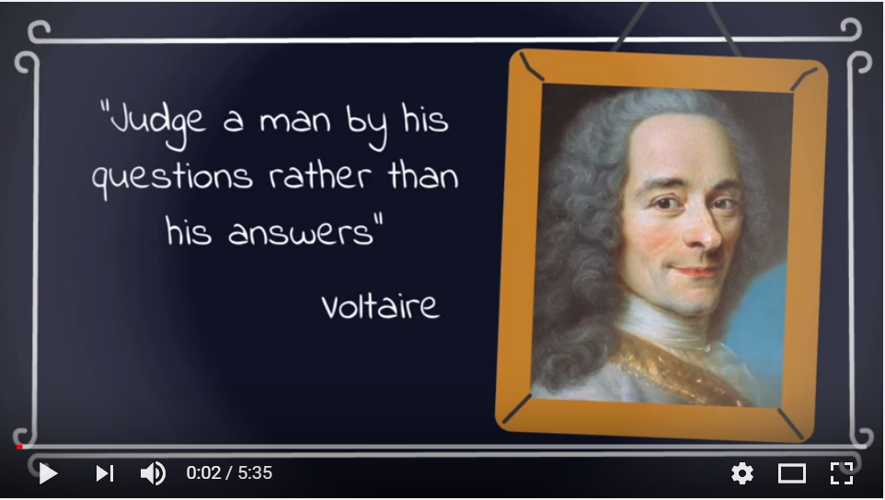
The power of effective questioning
What are powerful questions?
How are these different from the regular questions one would ask?
37
Notes:
Duration: 7 minutes
Facilitator Notes: This video focuses on improving the quality of the questions you ask and therefore improve the quality of your life.
DO:
Play the video either using the embedded link on the slide or alternatively use the following YouTube link: https://www.youtube.com/watch?v=1dO0dO__wmE
Once you’ve played the video, ask the participants the two debrief questions listed on the slide – What are powerful questions? How are these different from the regular questions one would ask?
Transition:
Let’s spend a little more time reviewing Questions and how they help in ensuring effective communication.

Slide 38

Questions are asked…
To obtain information
To help maintain control of a conversation
To build rapport and show empathy
To clarify a point and check agreement
To encourage further thought
Questioning is the key to gaining more information and without it, interpersonal communications can fail.
38
Notes:
Duration: 2 minutes
Facilitator Notes: This slide discusses some key elements of questioning. Use this slide to summarize key points from the video the participants have just viewed. Remember not to spend too much time in this section; the points have already been explained beautifully in the video. This is merely to recap the learning from the video.
DO:
Elicit responses from the participants and then use the key points to add to the discussion. Highlight that questioning is the key to gaining more information and without it, interpersonal communications can fail.
Use the notes below to support your explanation.
Explain:
One of the most effective tools in communication is the ability to ask questions. Being able to ask effective questions is a skill we must acquire. Skillful questioning is one of the key ingredients of solid and successful relationships, strategic planning, and significant exchange of information and opinions. Questions that are poorly constructed and weak can lead to a poor communication exchange and may cause misunderstanding.
Some of the key reasons we ask questions include:
To obtain information: The primary function of a question is to gain information – ‘What time is the meeting starting?’
To help maintain control of a conversation: While you are asking questions you are in control of the conversation. Assertive people are more likely to take control of conversations attempting to gain the information they need through questioning.
To build rapport and show empathy: Questioning allows us to find out more about the respondent; this can be useful when attempting to build rapport and show empathy or to simply get to know the other person better.
Continued on the next page.

Slide 39

Powerful questions can provoke action, and foster discovery, reduce confusion and open people up to possibilities and creativity.
By asking a powerful question you can take a conversation to a whole new level.
How might we ask more powerful questions?
Copyright © 2017 Accenture. All rights reserved. For Accenture Internal Use Only.
39
Notes:
Duration: 10 minutes
Facilitator Notes: This slide is merely to set context to the group activity on using powerful questions.
DO:
Ask the participants “How might we ask more powerful questions?”
Ask them to reflect on that question and let them know you’re not asking for answers.
After 30 seconds, ask the participants to get up and shuffle around and sit with someone they haven’t sat with so far in the session.
Now instruct the participants to work in pairs and start a conversation about their favorite vacation? They are only able to use questions that start with ‘what’. After 3 minutes, swap and ask the question to the other person. (A total of 6 minutes)
Ask the group these questions:
What happened?
What surprised you?
What did you notice?
How did it feel?
Ask the group – what are the characteristics of a powerful question and what are the benefits? Mouse click to show the content on the slide that summarizes the benefit of powerful questioning.
Give out post-its. Ask people to take a minute to write down a ‘what question’ they want to use several times for the rest of today e.g. ‘What are you excited about … “. Ask them to write it on a post-it note and take with them to remind them of their task.
Transition:
Now that you’ve written down the question you want to use several times for the rest of today, here is some quick practice work you can take with you beyond this workshop.

Slide 40

BACK AT WORK
In your next meeting, try to ask at least 5 powerful questions. This can be very impactful in a meeting with many people. Especially notice when you want to pipe in and “wow” people with your brilliant knowledge. That’s a perfect time for a powerful question.
Set up informal 10 minute meetings with the colleagues, and/or friends around you to try out your new skill. Notice the results.
In your next 5 conversations, pretend you know nothing.
Copyright © 2017 Accenture. All rights reserved. For Accenture Internal Use Only.
40
Notes:
Duration: 2 minutes
Facilitator Notes: Use this slide to set some post-training assignment. Tell the participants that this isn’t something that will be followed-up on or monitored. However, drive the point that this practice is what will help the participants move from asking good questions to asking powerful questions. Tell them that as part of the post-training session, they will receive a pdf document that contains examples of some powerful questions.
Transition:
On that note, let’s spend the next couple of minutes just unwinding, relaxing and attempting to listen to our breathe.

Slide 41

Just breathe…
Copyright © 2017 Accenture. All rights reserved. For Accenture Internal Use Only.
41
Notes:
Duration: 2 minutes
Facilitator Notes:
This is a quick 2 minute breathing exercise recommended to help destress everyone.
DO:
Instruct everyone to put aside everything that they are doing and just place their palms facing downwards on their laps. They can sit wherever they are.
Instruct them to sit in an upright position with their eyes closed and their hands on their lap.
Instruct them to breathe normally and observe their breath. Ask them to just declutter their mind and channel their entire focus on their breath as they inhale and exhale.
Instruct them to breathe in, hold for 5 seconds and breathe out. Repeat this instruction three to six times depending on the group’s restlessness levels – if the group is restless, have repeat the breathing technique till the seem relaxed.
Instruct them to keep their eyes closed and gently rub their palms and place them on their eyes.
Instruct them to open their eyes gently.
Transition:
I hope you feel a little light and relaxed. Now that we’ve worked on listening to our inner self and our breath, let us explore yet another key tool of effective communication and that is Active Listening.

Slide 42

Most people do not listen with the intent to understand; they listen with the intent to reply
- DR STEPHEN R COVEY
Copyright © 2017 Accenture. All rights reserved. For Accenture Internal Use Only.
42
Notes:
Duration: 2 minutes
Facilitator Notes: This slide covers listening skills as yet another key tool to effective communication and highlights the importance of active listening.
DO:
Start this session by presenting the quote by Dr Covey—one of the world’s foremost leadership authorities, organizational experts, and thought leaders. Ask the participants what the quote means to them and have them share their thoughts.
Then ask them what is the difference between hearing, listening and active listening? Elicit quick responses from the participants and use the points to add to the discussion.
Leverage the notes provided below to support your explanation.
In a Virtual Session:
Ask the participants to unmute themselves and respond.
Explain:
Listening is the ability to accurately receive and interpret messages in the communication process.
Listening is key to all effective communication, without the ability to listen effectively messages are easily misunderstood – communication breaks down and the sender of the message can easily become frustrated or irritated.
Good listening skills can lead to better client satisfaction, greater productivity with fewer mistakes, increased sharing of information that in turn can lead to more creative and innovative work.
Active listening involves listening with all senses. In addition to giving full attention to the speaker, it is important that the ‘active listener’ is also ‘seen’ to be listening - otherwise the speaker may conclude that what they are talking about is uninteresting to the listener.
Continued on next page

Slide 43
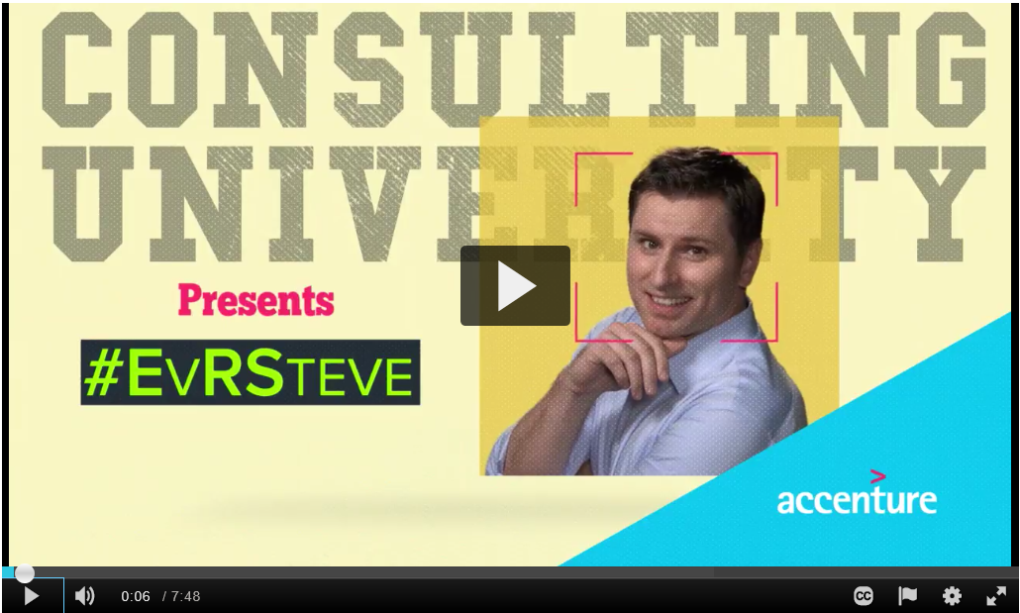
The three gears of listening
What key messages did you gather from this video?
43
Notes:
Duration: 10 minutes
Facilitator Notes: This video focuses on the three gears of listening. Let the participants know that this video is part of the Consulting University – Learning on Demand. Also share that the EvRSteve videos are a Telly Award-winning series of videos.
DO:
Play the video either using the embedded link on the slide or alternatively use the following Accenture MediaExchange link: https://mediaexchange.accenture.com/media/t/1_8m3pni89
Once you’ve played the video, ask the participants what key messages did they gather from this video.
Elicit quick responses and use the image on the next slide to discuss and summarize the three gears of listening.
Transition:
Let’s do a quick recap on the three gears of listening.

Slide 44
Recap: the three gears of listening
Non-Verbal Emotion
Observant
Gear
Confirm
Listen/
Content
Active
Gear
Receptive
Gear
Tell/ Relate
Ask Open-ended Questions
Copyright © 2017 Accenture. All rights reserved. For Accenture Internal Use Only.
44
Notes:
Duration: 5 minutes
Facilitator Notes: This slide provides further context to the three gears of listening. Use this more to do a quick recap of the three gears of listening.
Explain:
Listening is one of the most underrated tools in every day conversations and even more so in business. Effective and proactive listening can really help drive business success. Listening at the right level, however, is the key to getting the most from your qualitative and quantitative insights.
The Three Gears of Listening is a proven technique for listening. The cornerstone of building a trusted relationship with others is our ability to listen to what they are saying, how they saying it and then demonstrate our willingness to hear and respond to what we’ve heard. To truly be effective in our conversation and build trust and connect with others, our response should occur only after we are certain we have clarity of the other’s agenda, their issues and problems.
This model has three different gears that help you to maintain a forward, fluid motion in all of your conversations. You use the:
Active gear:
The first level of listening is the most basic. When you’re listening on the first level, you’re hearing the audio that comes out of someone’s mouth – but you’re mostly focused internally on your own thoughts, priorities, and worries. In a personal sense, this means half listening about a project, while you’re wondering how you’re going to get the kids to practice this evening, and receiving a list of to-dos while you’re panicking about workload. In this level, you are doing all the talking or “driving” the conversation to organize resources, to affect a result, and get something done.
In this gear you have the ability to organize resources and get things done. Active Gear is comfortable and feels most productive. And yet, when used prematurely or excessively, Active Gear will strain and potentially damage even our best business relationships.
Continued on next page

Slide 45

Shhhh… just listen…
How did the speaker feel when the person just listened and did not exchange information?
How did the non-verbal signals encouraged the speaker?
How uncomfortable was the silence?
How did it feel to just listen without having the pressure to contribute?
How did the speaker feel having the freedom to say whatever he/she felt?
Notes:
Duration: 12 minutes (2 minutes to instruct and split into groups, 3 minutes to run first part of exercise, 3 minutes to debrief with questions on slide, 2 minutes to run second part and 2 minutes to debrief)
Facilitator Notes: This is a simple, quick exercise to run, and then to talk with the group about the power of active listening.
DO:
Split the group into pairs - As and Bs. Ensure you get the group to mix around and not just pair up with someone sitting beside them. A good way to do this is to first divide the group into two equal straight lines. Then have them pair up with the first in line A pairing with the last in line B and follow the order till all are paired. Note: should you have an odd one out, have them group with one of the pairs but be part of group A.
Take Bs out of the room and ask them to wait outside.
Inform the As that while they are listening to their partner, every time their partner says something that evokes their 'inner voice' i.e. they want to ask a question or makes them think about something, they put their hand up for five seconds then put it back down.
Ask them to do this for the entire conversation. The As are not allowed to interact with Bs, ask questions, affirm understanding etc.. As remain silent, just raising their hand every time their inner voice kicks in. You can also ask the As to not only raise their hand, but also lose focus, i.e. start staring out the window, become transfixed with the detail on their partner's jacket, etc...another obvious distraction to their listening.
Next inform the Bs outside that they are to speak to As about something of interest, an experience, their last holiday or anything positive that has happened to them in the last six months. They have three minutes to talk.
Ask Bs back into the room, then allow three minutes of talking from Bs.
At the end of the three minutes ask the Bs the questions displayed on the slide. General answers back are normally 'didn't feel listened to, didn't understand why they were putting their hand up, lost my train of thought because they obviously weren't listening,' etc...
Continued on next page

Slide 46
Shhhh… just listen…
How did the speaker feel this time?
What was the highlight of this interaction?
How did the listener feel?
Notes:
Continued from previous page
Run the exercise again, this time allowing the As to interact, ask questions, become involved in the conversation etc...
At the end of three minutes, compare the two conversations to understand which conversation was more satisfying and why.
In a Virtual Session:
Have the teams split into two groups at each location in the same manner as recommended for local sessions. Request group B to step out and wait. Provide instructions to group A. Then have group A step out quickly so you can provide instructions to group B.
Have the two groups step back in and pair up. Conduct the session.
For the second round of interactions, the instructions can be provided with all in the room.
Transition:
On that note, let’s take a 60 minute break to… RELAX, REFRESH and RECHARGE ourselves.

Slide 47

Copyright © 2017 Accenture. All rights reserved. For Accenture Internal Use Only.
47
Notes:
LUNCH BREAK
Duration: 60 minutes
On return:
Welcome back and I hope you’ve had enough time to Relax, Refresh and Recharge yourselves. Going back to where we stopped before lunch.
A great way to demonstrate active listening is to ask timely and effective questions and we’ve already covered that earlier in this course.
Another way to demonstrate active listening is by seeking clarification and validation of what you’ve listened to. In other words, Paraphrasing.
Let’s look at how we can paraphrase effectively to further enhance our communication skills.

Slide 48
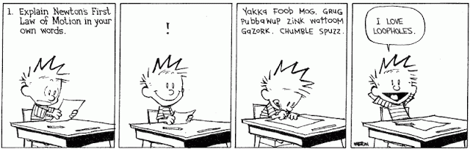
How does paraphrasing support effective communication?
What are the key things you will need to keep in mind when paraphrasing?
48
Notes:
Duration: 2 minutes
Facilitator Notes: This slide highlights the importance of paraphrasing and what we can do to ensure we paraphrase effectively.
DO:
Introduce this session by showing the cartoon strip. Ask participants about their current understanding of paraphrasing and how they use it as an effective tool to communicate.
Ask the participants the two questions and elicit quick responses.
Use the notes provided below to support your explanation.
Explain:
Paraphrasing is repeating in your words what you interpreted someone else to be saying. Paraphrasing is powerful means to further the understanding of the other person and yourself, and can greatly increase the impact of another’s comments. It can translate comments so that even more people can understand them.
Put the focus of the paraphrase on what the other person implied, not on what you wanted him/her to imply, e.g., don’t say, “I believe what you meant to say was …”. Instead, say “If I’m hearing you right, you conveyed that …?”
Paraphrase as a question, “So you’re saying that …?”, so that the other person has the responsibility and opportunity to refine his/her original comments in response to your question. Put the focus of the paraphrase on the other person. For example, if the person said, “I don’t get enough resources to do what I want,” then don’t paraphrase, “We probably all don’t get what we want, right?”
Put the ownership of the paraphrase on yourself, e.g., “If I’m hearing you right …?” or “If I understand you correctly …?”
Put the ownership of the other person’s words on him/her, e.g., say “If I understand you right, you’re saying that …?” or “… you believe that …?” or “… you feel that …?” In the paraphrase, use some of the words that the other person used.
Continued on next page

Slide 49
paraphrasing
Put the focus of the paraphrase on what the other person implied, not on what you wanted him/her to imply
Ask questions while paraphrasing, so that the other person has the responsibility and opportunity to refine his/her original comments in response to your question
Keep your assumptions and prejudices at bay
When paraphrasing, look for non-verbal as well as verbal cues that confirm or deny the accuracy of your understanding.
Empathize to demonstrate that you care for the client’s requirements and acknowledge their challenges and concerns
Paraphrasing is a powerful technique to further deepen your and others’ understanding of the ideas shared by restating the idea to validate.
49
Notes:
Continued from previous page
For example, if the other person said, “I think we should do more planning around here.” You might paraphrase, “If I’m hearing you right in this strategic planning workshop, you believe that more strategic planning should be done in our community?”
Don’t judge or evaluate the other person’s comments, e.g., don’t say, “I wonder if you really believe that?” or “Don’t you feel out-on-a-limb making that comment?” You can use a paraphrase to validate your impression of the other’s comments, e.g., you could say, “So you were frustrated when …?”
The paraphrase should be shorter than the original comments made by the other person. If the other person responds to your paraphrase that you still don’t understand him/her, then give the other person 1-2 chances to restate his position. Then you might cease the paraphrasing; otherwise, you might embarrass or provoke the other person.
Transition:
Now that we’ve looked at questioning, active listening and paraphrasing, let us look at the last key tool in ensuring we communicate effectively – summarizing.

Slide 50

A summary is a brief rundown covering the main points that you have covered in your conversation.
It is vital when summarizing that you are concise; you don't want to repeat the entire conversation all over again.
Copyright © 2017 Accenture. All rights reserved. For Accenture Internal Use Only.
50
Notes:
Duration: 5 minutes
Facilitator Notes: This slide covers the core essence of the process of summarizing.
DO:
Reveal the definition of a summary (text in white) first and get responses from the participants. Ask them why is it important to summarize.
Elicit quick responses and use the notes provided below to build on the interaction.
Reveal the text in black to transition to the next slide that covers the key steps to summarizing effectively.
In a Virtual Session:
Ask the participants to unmute themselves and respond.
Explain:
The skill of summarizing is an essential yet often overlooked step in the communication process. Whether people realize it or not, summarizing can add a whole new dimension to verbal communication both in a business and personal setting.
A good summary can verify that people are understanding each other, can make communications more efficient, and can ensure that the highlights of communications are captured and utilized.
You summarize to:
Check each person's understanding of what has been said to that point
Note any special and important points from the conversation that you feel need to be highlighted
Bring the conversation to a close
Restate any contracts or agreements made during the conversation
Refresh each others memory of what has been discussed
It is vital when summarizing that you are concise; you don't want to repeat the entire conversation all over again.
Transition:
So what are the key things to remember when summarizing?

Slide 51

What are they key things to remember when summarizing?
Introduce the summary; let the person you are communicating with know you are going to summarize the discussion
Keep your summary to the point and don't cloud it with unnecessary information
Ensure you include three key elements that must be infused in a summary—Facts, Information, Agreements and Responsibilities
Check the other person’s understanding in order to be sure you have summarized correctly
51
Notes:
Duration: 5 minutes
Facilitator Notes: This slide covers the key steps needed to summarize effectively.
DO:
Reveal the questions and elicit responses from the participants.
Allow for quick discussion and use the points provided on the slide to wrap up the conversation and recap the key points.
In a Virtual Session:
Ask the participants to unmute themselves and respond.
Explain:
The skill of summarizing is an essential yet often overlooked step in the communication process. Whether people realize it or not, summarizing can add a whole new dimension to verbal communication both in a business and personal setting.
A good summary can verify that people are understanding each other, can make communications more efficient, and can ensure that the highlights of communications are captured and utilized.
Transition:
We’ve seen that summarizing is an essential step in the communication process. Let’s now work on an activity to see if we are able to effectively use all the communication techniques that we have discussed

Slide 52

storytelling
The storytelling framework helps you overcome gaps in your audience's background knowledge, and the story you tell can be tailored to suit the business challenge you or your client faces.
Effective Stories are:
Simple
Relevant
Inclusive
Emotional
Friendly, not cynical
Shared by many people
52
Notes:
Duration: 3 minutes
Facilitator Notes: This slide highlights how one can use storytelling as an effective communication technique.
DO:
Explain the concept of storytelling using the notes below.
Explain:
Crafting a story in which to present your data is a powerful way to connect with audiences. The storytelling framework will help you overcome gaps in your audience's background knowledge, and the story you tell can be tailored to suit the business challenge you or your client faces.
Telling stories to convey information more effectively is an evidence-based practice. More activity occurs in the brain as we listen to stories than happens when we are presented with a list of facts. Being presented with a story may also help an audience better understand your point of view.
Done well, storytelling can be a powerful catalyst for driving transformational change. Effective leaders tell stories that position them and their organizations as change agents instead of defenders of the status quo.
Effective stories are
Simple – listeners are not overwhelmed with detailed facts and information
Relevant – the purpose and theme of the story matters to those who hear it
Inclusive – everyone can see themselves in the story
Emotional – the story excites, delights, surprises, or otherwise moves the listener at an emotional level. It engages multiple senses.
Friendly, not cynical – even sad stories should leave the listener feeling hope, understanding or satisfaction
Continued on next page

Slide 53


Structure your story
Crafting a story in which to present your data is a powerful way to connect with audiences.
Structure the story around a Process
Begin with an Anecdote
Begin with Global Findings, then Zoom In
Set the Stage for Future Exploration
Establish a Vision for the future
“Stories constitute the single most powerful weapon in a leader’s arsenal.” — Dr. Howard Gardner, Professor Harvard University
53
Notes:
Duration: 3 minutes
Facilitator Notes: This slide highlights how one can use storytelling as an effective communication technique.
DO:
Explain the concept of storytelling using the notes below.
Explain:
Unlike other methods of influence, such as persuasion, bribery, or charismatic appeal (all push strategies), stories are pull strategy. Stories allow people to decide for themselves, which is one of the great hallmarks of effective influence.
An effective story has five key steps:
Structure the story around a Process. Divide your story into before, during and after segments. Organize your story into parts: problem statement, activities and results.
Include a timeline of your activities.
Begin with an Anecdote. Describe the situation that inspired the project. Explain the project's significance to you. Describe a memorable moment that occurred while you worked on the project. Tell a story that focuses on everyday people and their real-life interactions with the technology that gathered the data.
Begin with Global Findings, Then Zoom In. Start with a high-level overview, then highlight notable insights and t\he potential impacts on day-to-day activities. Provide an overview of the whole picture and then describe how the pieces of the whole fit together.
Set the Stage for Future Exploration. Provide the context, guides and tools of exploration. Allow audience members to build on your work and develop their own insights.
Establish a Vision for the Future: Describe the current situation, the potential for change and how to effect change.
Continued on next page

Slide 54

What approach do you take when communicating with your team?
T
Take inputs
E
Empathize
A
Actively listen
M
Moderate approach
Copyright © 2017 Accenture. All rights reserved. For Accenture Internal Use Only.
54
Notes:
Duration: 3 minutes
Facilitator Notes: This slide provides quick tips/pointers people can follow when communicating with their teams.
Do:
Start by asking the participants what approach they take when communicating with their team(s).
Elicit responses from the participants and make notes either on a flipchart or whiteboard/wipe board.
Use the slide to then summarize the key points and use the explanation in the notes below to elaborate each of the four points.
Explain:
The key approach lies in the word “team” and it essentially spells out as:
Take inputs: Encourage the members in the team to provide inputs. Make it clear that their inputs are valuable.
Empathize: When someone has a different point of view than yours or the groups’, you need to take inputs and empathize with them.
Actively Listen: If the team members feel that you are not actively listening to their ideas, they become more reluctant in participating or digress from the main discussion. So make sure you are attentively listening to what they have to say.
Moderate approach: For anything you need to do when you meet the team, you need to hare their thoughts/ideas/concerns.
Transition:
We’ve looked at some basic tips to follow when communicating with our teams. Let’s put all that we’ve gather to some quick practice.

Slide 55
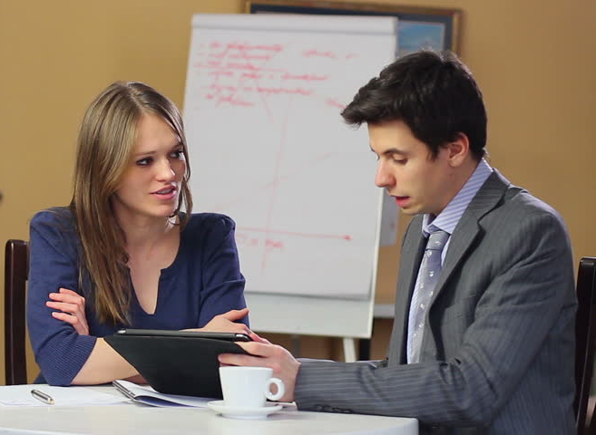

Let’s discuss…
Susan and Marshal are working on a new project requirement. The client has shared high level information on the requirement as part of their initial discussion, but the scope still needs to be fleshed out in detail.
Together, Susan and Marshal decide to create a requirement specifications document template and populate it with the information that they have managed to gather so far. They then set up a follow-up meeting with the client to enquire more about the requirement and validate their understanding.
How should Susan and Marshal go about preparing for this meeting?
From what you have learned so far, which communication techniques can they leverage to better capture the requirements and validate their understanding?
If you were in a similar situation, what questions would you ask the client when initiating a new project in your team?
Copyright © 2017 Accenture. All rights reserved. For Accenture Internal Use Only.
55
Notes:
Duration: 5 minutes
Facilitator Notes: The intent of this discussion is to use the scenario on the slide to gauge the participants’ understanding of effective communication.
DO:
Read out the case scenario on the slide and extract reactions from the participants on the questions in the question box.
Explain:
Supporting points on what Susan and Marshal could do for an effective communication:
Should come prepared for the meeting with all the relevant question they have
Should come prepared for the meeting with ideas of their own
Should pay attention and listen to the client
Should understand the ideas and opinions shared by the client
Should ask clarifying questions if required
Examples that could be used:
a) Tech: An application to manage Order Management for a Retail Account.
b) Process (Operations): Credit Card Payment Reconciliation Process
Key Takeaways:
Relevant questions get you relevant answers
Communication techniques need to be different for different results
Being prepared can save us a lot of time & energy
Transition:
Now that we’ve tried building on conversations within team members, let’s shift our focus to clients and stakeholders. So, what are the various types of client conversations that you may have at the workplace?

Slide 56



What are the various types of client conversations that you may have at the workplace?
Discovery Conversations
These conversations focus on listening to clients and asking open-ended questions to gather more data about their requirements
Often discovery conversations happen at the beginning of a client engagement, but you can engage in these dialogues in an ongoing manner
Transactional Conversations
These conversations are focused on sharing project/process-related updates and requirements during regular coordination connects with clients
Provide facts and ensure you seek agreement on the key actionables
Ensure that you have the agenda for the conversation ready
Charged Conversations
These conversations occur when clients have emotional reactions that result from a disconnect or disappointment with any service provided
Ensure you empathize and listen to what the client has to say and earn the trust and confidence of the client to tackle the risk-related conversations
Copyright © 2017 Accenture. All rights reserved. For Accenture Internal Use Only.
56
Notes:
Duration: 3 minutes
Facilitator Notes: This slide comprises some of the common types of client conversations.
DO:
Start this section by asking the participants what they believe are the key reasons to interact with the client. Elicit responses from the participants.
Use the points listed on the slide to further support the discussion.
Transition:
Now that we’ve understand the key reasons we connect with our clients, let’s look at a simple approach to carrying out simple client interactions.

Slide 57
What are the various types of client conversations that you may have at the workplace?
Close the conversation
Review agreements and action items and assign responsibilities
Agree on next steps and next connect
Run the conversation
Manage the discussion and ensure the clients are engaged throughout the conversation
Manage time and direct the conversation back on track if anyone deviates
Use questioning, listening and paraphrasing skills to get the most out of the conversation
Open the conversation
Start with an enthusiastic tone and use an icebreaker, if necessary, to help get everyone comfortable
Build rapport to establish a mutual feeling of respect
Review agenda, desired outcomes and define ownership of topics
Plan the conversation
Have a well-defined agenda ready and be clear about the intended outcomes
Ensure you have all the key stakeholders and their interests factored in
Prepare and set expectations in advance, if needed
Copyright © 2017 Accenture. All rights reserved. For Accenture Internal Use Only.
57
Notes:
Duration: 3 minutes
Facilitator Notes: This slide comprises some of the common types of client conversations.
DO:
Start this section by asking the participants what they believe are the key reasons to interact with the client. Elicit responses from the participants.
Use the points listed on the slide to further support the discussion.
Transition:
Let’s put this understanding to practice now.

Slide 58



Mohan, a project manager, has recently been interacting virtually with a prospective client, Laura. All the formal documents have been signed and the project is expected to start in a week’s time. Mohan is informed that Laura and some of her leads on the project are planning to visit the offshore team. He feels that this will give him an opportunity to understand the project specifics and requirements better.
Laura, the client, hopes that this meeting will enable both Mohan and her to set the expectations right. She wants to use this opportunity to answer any questions that Mohan and his team may have and clarify the project objectives and details.
Was Mohan able to use powerful questioning effectively to get the required details from Laura?
Did Mohan use active listening and paraphrasing skills to their best use to understand the needs of the project? What could he have done better?
Copyright © 2017 Accenture. All rights reserved. For Accenture Internal Use Only.
58
Notes:
Duration: 7 minutes (2 minutes for set up + 3 minutes for the role play+2 minutes to discuss)
Facilitator Notes: In this activity, the participants will go through a scenario, enact it, and discuss it. The intent of this activity is to help the participants use the three techniques of powerful questioning, active listening, and paraphrasing to communicate effectively.
DO:
Explain the scenario to the participants.
Ask two participants to volunteer for the roles of Mohan and Susan.
Provide tips to the volunteers on how to enact the scenario. Explain to the participant enacting the role of Mohan that the intent of the meeting is to use the three techniques (powerful questioning, active listening, and paraphrasing) to understand the client’s needs and expectations. He should be able to get the answers to all the questions that he has. The volunteer enacting the role of Susan should judge as a client whether Mohan will be able to deliver as per the requirement.
Ask the remaining participants to carefully observe the role play and note their observations in their notepads.
After the role play, ask the participants to respond to the questions in the green box.
Transition:
Let us look at the key takeaways.

Slide 59

KEY TAKEAWAYS
Ask powerful questions to gauge and understand expectations better
Use powerful questioning to probe further and clarify your questions
Listen actively to understand what is being told
Paraphrase effectively to understand the client’s requirements and get a confirmation on the actionable items
Combine the three techniques to define the expected solutions and get a commitment from the client
59
Notes:
Duration: 2 minutes
Facilitator Notes: Use this slide to highlight the key takeaways from the role play.
DO:
Share content of the slides one after the other.

Slide 60

When do conversations get difficult? What triggers a difficult conversation?
What are the common reasons that require you to have a difficult conversation with a client?
Missed deadlines
Poor quality of the deliverable
Miscommunication
Cultural differences and lack of sensitization
Lack of understanding on the project requirements
Mismatch between expectation and deliverable triggered by lack of understanding of the client’s industry
Copyright © 2017 Accenture. All rights reserved. For Accenture Internal Use Only.
60
Notes:
Duration: 2 minutes
Facilitator Notes: This slide explains the common challenges faced when conversing with clients.
DO:
Ask the participants to respond to the question presented on the slide.
After receiving a few responses, reveal the content.
In a Virtual Session:
Ask the participants to unmute themselves and share their responses.
Explain:
Difficult client conversations are situations that we always try to avoid.
Some of the difficult client conversations can revolve around your performance, missing deadlines, or issues that occurred due to miscommunication.
Other examples of difficult client conversations are:
When you have to say ‘No’ to some demand made by the client
When you have to highlight issues or risks
When you have to point out the client’s slipups
When you have to follow-up on an actionable from the client’s side
None of us prefer to have a difficult conversation. A difficult client conversation is usually preceded by anxiety, fear, and distress.
However, rather than avoiding it, it is best to face the difficult situation and resolve it with the client.
Transition:
Let’s look at how we can work on handling these difficult conversations.

Slide 61

Handling difficult conversations
Difficult client conversations can be handled by following some best practices.
Act early and have a plan
Have realistic goals
Do not hesitate to give bad news
Adopt the ‘And’ stance
Do not blame
Paraphrase
Be prepared for the reaction
Own your share of responsibility
Be empathetic and calm
Copyright © 2017 Accenture. All rights reserved. For Accenture Internal Use Only.
61
Notes:
Duration: 3 minutes
Facilitator Notes: This slide covers some tips to handle a difficult client conversation.
DO:
Tell the participants this is a takeaway slide from the video that they watched in the previous slide.
Use the tips provided on the slide and explanation in the notes section to help the participants understand how to handle difficult client conversation effectively.
Explain:
Act early and have a plan: If you see a problem arising, tackle it and try to resolve it at the earliest.
Have realistic goals: Do not create a grand picture in front of your client, which cannot be fulfilled. Even if the client is inflexible, you need to place the reality in front of the client. You should stay focused on providing an achievable goal to your client. Spend your energy on preparation and focus on developing your specific script.
Do not hesitate to give the bad news: It is vital to show the real picture to your client, before he/she takes the expectations to an unknown level. Even if you have done a mistake or missed a deadline, it is better to keep the client informed about it at all times. This will save your relationship with the client in the long run and will help build trust.
Adopt the ‘And’ stance: Take control of the conversation by pre-empting distractions and objections by using ‘and’. For example, “I know you worked all night, and I know you want to do well, and I know you just joined the company, and I know the graphics people sometimes get the data wrong, and I know I could have been clearer in my directions to you….”
Do not blame: Everyone has their own reason and objective for doing or saying something. You should try to avoid the blame-game and instead focus on the solution and how to avoid errors in the future.
Continued on the next page.

Slide 62
Mohan and his team are working with Laura on the project. However, of late, he has been facing issues with Laura. She has started acting difficult and does not share information that is required to take the project forward. She is also being unreasonable in her demands, though Mohan had set the expectations right at the beginning. Mohan has to find a way to deal with the situation.
Laura feels that Mohan is being unreasonable and not delivering as she had expected. He is making too many demands and asking for too much information without giving her enough time to gather them.
Mohan sets up a meeting with Laura to discuss the issues so that they can be resolved and the project suffers no further delays or issues.
Do you think the meeting went as expected? Was Mohan able to effectively handle the difficult situation?
What could have Mohan done differently to make the meeting more effective?
62
Notes:
Duration: 5 minutes (2 minutes for set up + 3 minutes for the role play)
Facilitator Notes: This activity is the continuation of the previous role play in module two. It will help the participants understand that it is vital to build a good relationship with their client, in order to discuss critical situations and handle difficult conversations.
DO:
Explain the scenario to the participants.
Ask two participants from the audience to volunteer for the roles of Mohan and Susan. You can ask the same participants, as the previous role play, to volunteer.
Provide tips to the volunteers on how to enact the scenario. Explain to the participant enacting the role of Mohan that the intent is not to be hostile to the client but resolve the issue. He has to present his issues, while not sounding aggressive. The objective of the meeting is to solve the issues as well as to retain the client relationship for future.
Ask the remaining participants to carefully observe the role play and note their observations in their notepads
Once the role play is completed, discuss the questions on the slide.
Prompt the participants to think if Mohan did something extraordinary to handle the situation or committed a grave wrong in the way he conducted himself, which could have hampered his relationship with Susan.
Transition:
Lets look at the key takeaways from this exercise.

Slide 63
KEY TAKEAWAYS
Avoid the blame-game and focus on the solution
Summarize the key points to let the client know that you are aware of the complete situation
Own your share of responsibility and try to resolve it
Arrive at the key actionable items and timelines
63
Notes:
Duration: 3 minutes
Facilitator Notes: This slide provides the key takeaways.
Transition:
We have reached the end of the Day 1 of our workshop.

Slide 64
Questions around the table?
Copyright © 2017 Accenture. All rights reserved. For Accenture Internal Use Only.
64
Notes:
Duration: 2 minutes
DO:
Tell participants about tomorrow’s module Skills Practice Activity, in which they get to practice a challenging verbal communication situation, with a colleague playing their partner in the conversation, and another colleague observing and giving feedback. This is their chance to put into practice everything they have learnt today and tomorrow morning, practice a real-life situation and work on their effective communication skills.
Tell participants about tomorrow’s module Your Own Skills Practice Scenario, in which they get to practice a challenging verbal communication situation, with a colleague playing their partner in the conversation, and another colleague observing and giving feedback. This is their chance to put into practice everything they have learnt today and tomorrow morning, practice a real-life situation and work on their effective communication skills.
Participants take the time to pick a communication situation that they find challenging and wish to practice. For example, this can be:
A future communication situation that will take place soon
A communication situation from the past that didn’t go well and they wish to practice that particular situation for the future
A typical communication situation which they know is always challenging for them, perhaps related to their own personal style and dealing with styles of others
To ensure that the role play tomorrow is as helpful as possible, participants need to fill out a form in which they describe the situation:
What is the communication challenge they wish to practice
Background and context of the role-play situation
Brief instructions on how they want their role-play partner to act
Instructions on what they want their observer to pay attention to and provide feedback on
Continued on next page.

